Slide 1






Compressive sensing of audio signals
Physics 305 Activity 3
2nd Sem AY 2022-2023
Mark Jeremy G. Narag
2014-64423
PhD Physics

Slide 2

All the codes and files in this activity are available on my Github: https://github.com/mgnarag/physics305_computational_imaging
A part of my code in this activity is from Cleve Moler of mathworks: https://www.mathworks.com/company/newsletters/articles/magic-reconstruction-compressed-sensing.html

Slide 3
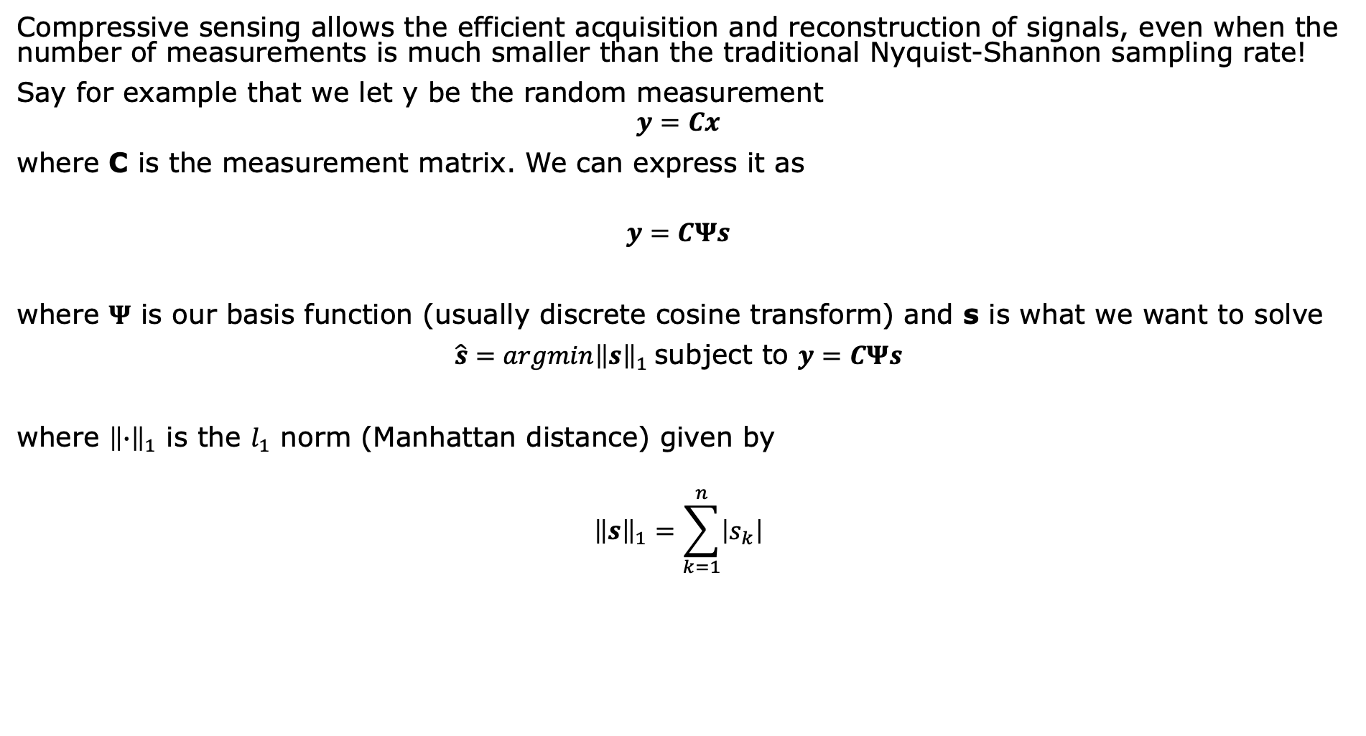
Compressive sensing
Background | Methods | Results and Discussion
Compressive sensing allows the efficient acquisition and reconstruction of signals, even when the number of measurements is much smaller than the traditional Nyquist-Shannon sampling rate!
Say for example that we let y be the random measurement
$$y=Cx$$
where C is the measurement matrix. We can express it as
$$y=CΨs$$
where $Ψ$ is our basis function (usually discrete cosine transform) and s is what we want to solve
$\hat{s}=argmin{\left\|s\right\|}_{1}$subject to $y=CΨs$
where ${\left\|∙\right\|}_{1}$ is the $l_{1}$ norm (Manhattan distance) given by
$${\left\|s\right\|}_{1}=\sum_{k=1}^{n}{\left|s_{k}\right|}$$
Equation from Ma’am Jing’s note on Compressive sensing

Slide 4
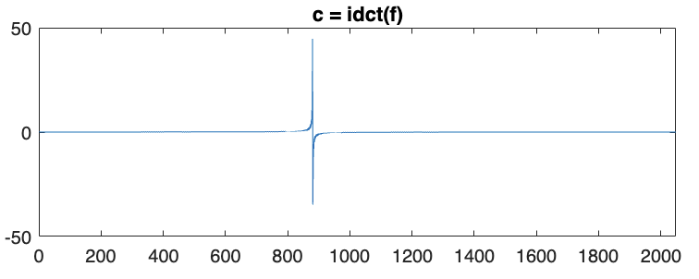
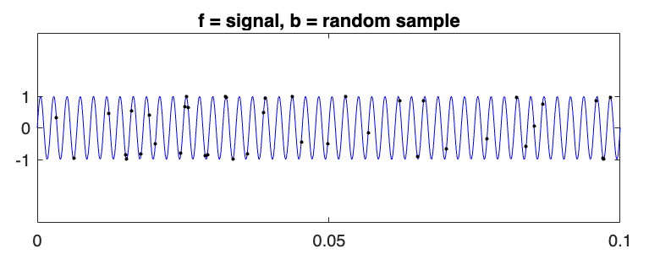
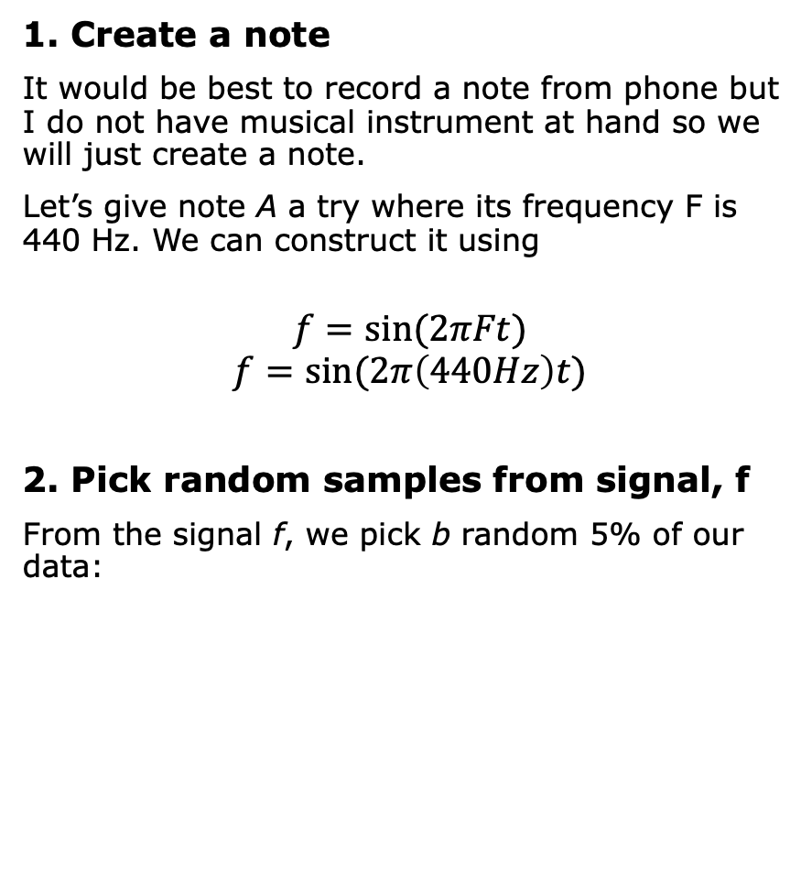
Background | Methods | Results and Discussion
1. Create a note
It would be best to record a note from phone but I do not have musical instrument at hand so we will just create a note.
Let’s give note A a try where its frequency F is 440 Hz. We can construct it using
$$f=sin⁡(2πFt)$$
$$f=sin⁡(2π\left(440Hz\right)t)$$
2. Pick random samples from signal, f
From the signal f, we pick b random 5% of our data:
Let’s also visualize the inverse discrete transform of signal f where we see spike at the appropriate frequency. This will be our basis later:

Slide 5
Background | Methods | Results and Discussion
3. Make it a linear system, Ax=b
The condensed signal is a vector b of m random samples of the original signal f. We construct a matrix A by extracting m rows from the n-by-n DCT matrix
A = D(k,:)
where k is the vector of indices used for the sample b. The resulting linear system is in the form Ax = b, with size m-by-n, which in our case is 410 by 8193.
There are 20 times as many unknowns as equations!
4. Find solution to Ax = b
To reconstruct the signal, we need to find the solution to Ax = b that minimizes the l1 norm of x.
In Matlab, we will use the l1-magic package written by Justin Romberg and Emmanuel Candès. Specifically, we will use the function l1eq_pd
5. Reconstruction
Finally, after getting x, we can reconstruct the signal by getting the DCT of x
4.1 OPTIONAL: We can also opt to solve the traditional l₂, or least squares, solution to Ax = b, computed by x = pinv(A)*b where pinv is a pseudoinverse that produces a matrix x of the same dimensions as A' so that A*X*A = A, X*A*X = X and A*X and X*A are Hermitian.

Slide 6
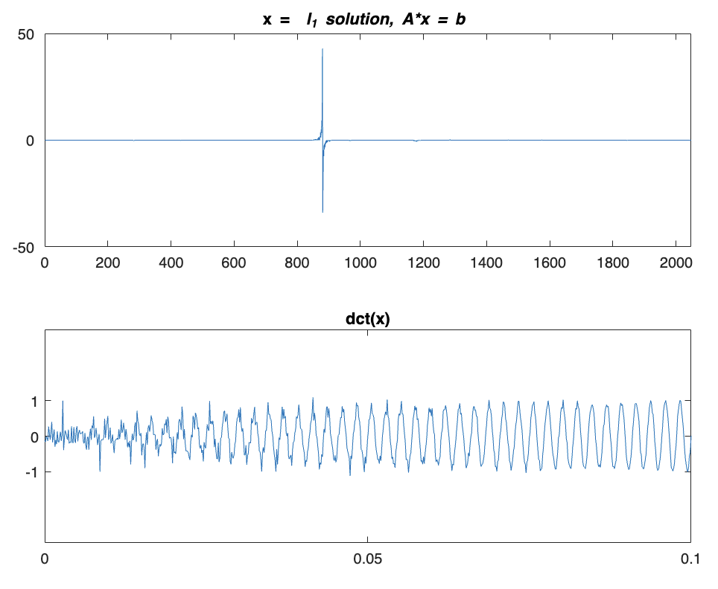

Background | Methods | Results and Discussion
On top is x which is the l1 solution while on the bottom is the reconstructed signal f with only 5% sampling rate!
A_l1.wav
PLAY IT HERE!
original
reconstructed
In comparison to the original:

Slide 7
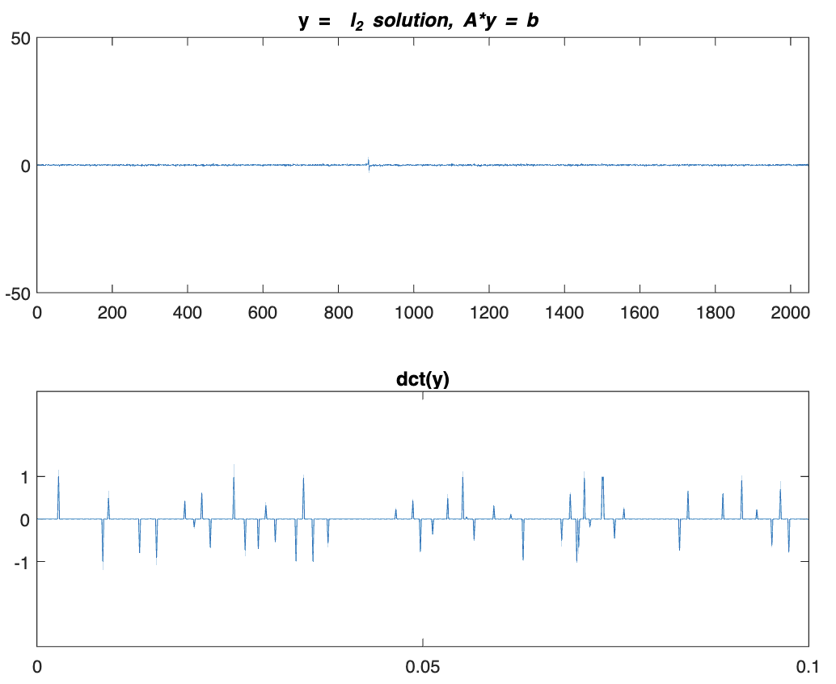
Background | Methods | Results and Discussion
Additionally, let’s try the traditional l₂ or least squares. We expect it to be noisy and not good (as can be seen from the reconstructed signal and the sound itself).
PLAY IT HERE!
original
Reconstructed using l₁
Reconstructed using l₂

Slide 8
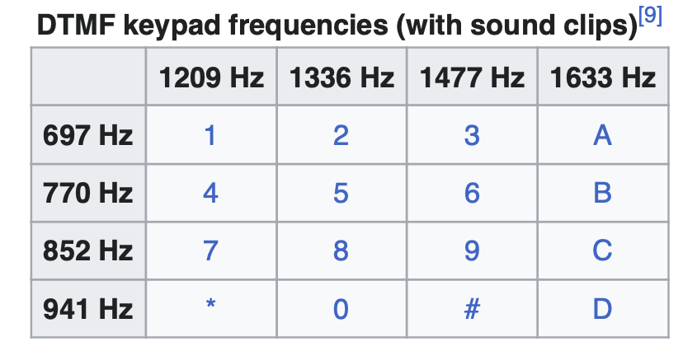
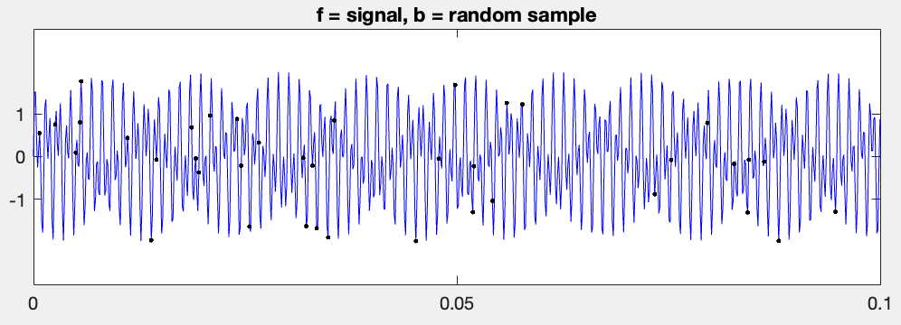
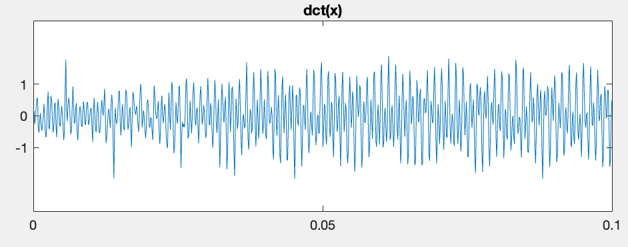
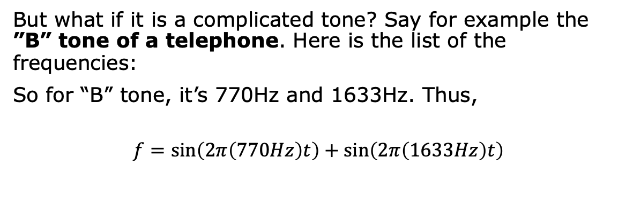
Background | Methods | Results and Discussion
But what if it is a complicated tone? Say for example the ”B” tone of a telephone. Here is the list of the frequencies:
So for “B” tone, it’s 770Hz and 1633Hz. Thus,
$$f=\sin\left(2π\left(770Hz\right)t\right)+\sin\left(2π\left(1633Hz\right)t\right)$$
PLAY IT HERE!
original
Reconstructed using l₁
Almost the same tune!!!
[9] Don Lancaster. "TV Typewriter Cookbook". (TV Typewriter). Section "400-Style (Touch-Tone) Modems". p. 177-178.

Slide 9
Background | Methods | Results and Discussion
Now, let’s automate our code and try to play a song!
Ba-ba-black sheep/twinkle twinkle star has the note [A,A,E,E,Fbar,Fbar,E,E,D,D] where
A = 440; %Frequency of note A is 440 Hz
E = 659.26; %Frequency of note E
Fbar = 739.99; %Frequency of note F#
D= 587.33; %Frequency of note D
The reconstruction here is actually long…
PLAY BA BA BLACK SHEEP HERE!
original
Reconstructed using l₁
YAY! Almost the same tune!!!

Slide 10
Background | Methods | Results and Discussion
Conclusion:
We were able to reconstruct the audio using only 5% of the original data!
The downfall is that the reconstruction is actually very slow
Also, in Matlab, only few optimization function works. I had a problem installing some of the minimization packages like ConVeX (cvx) optimization package and CoSaMP - Compressed Sensing Matching Pursuit so I was thankful that I found the L1-magic package. It is actually not a built-in package. I found it deep down the internet forums :)
It would be nice to measure the difference – like PSNR on images.
Future works may include trying much lower sampling rate and applying a metric to judge the reconstructed sound.

Slide 11
Reflection
I don’t do audio signals that much but this activity is very exciting! I can’t believe I did it I was actually scared to do this because it’s not an image anymore (weird to like 2D than 1D signal hehe).
CRITERIA | QUALIFICATIONS | SCORE
Technical correctness | Met all objectives. Theory is discussed sufficiently. Procedures and Results are complete. Procedures and Results are verifiably correct. Understood the lesson. | 40
Quality of presentation | All text and images are of good quality. Code has sufficient comments and guides. All plots are properly labeled and are visually understandable. The report is clear. | 30
Self-Reflection | Explained the validity of results. Discussed what went right or wrong in the activity. Justified the self-score. Acknowledged sources (e.g. persons consulted, references, etc.) | 30
Initiative | Experimented beyond what was required. Yes – I did l_2 minimization too Made significant improvements to existing code. Yes – automated a code that asks for several notes then outputs the compressed sound like the one I used in twinkle twinkle Analyzed limitations or potential of technique, etc. Yes | 10
100

